Slide 1
2020 Stage 3 Parent Information Evening

Slide 2
Prayer
Dear God,
Thank you for the gift of education in every form.
As our children start a new year, may grace be their guide and may hope be their compass toward a bright future.
We pray they would have eyes to see the needs of those around them and a heart to love well.
May they face each day with positivity knowing that no matter what comes their way, they do not have to face it alone.
Amen
Notes:
Christine

Slide 3
Hello!
Year 5
5B - Christine Dunk - christine.dunk@dbb.catholic.edu.au (M-W, F) and Lisa Kazzaz - lisa.kazzaz@dbb.catholic.edu.au (Th)
5W - Tori Jones - tori.jones@dbb.catholic.edu.au (M-T, even W) and Sharon Fountain - sharon.fountain@dbb.catholic.edu.au (odd W, Th-F)
Year 6
6B - Pauline Douglas - pauline.douglas@dbb.catholic.edu.au (M-T, odd W) and Natalie Ingram - natalie.ingram@dbb.catholic.edu.au (even W, Th-F)
6W - Liz Rath - liz.rath@dbb.catholic.edu.au

Slide 4
Class Parents Get involved!
Notes:
We now have class parents for all Stage 3 classes – thanks!
Year 5 class parents are responsible for Grandparents Day (Term 3) and Year 6 class parents are responsible for Year 6 Graduation/gift to the school (Term 4).
Both Year 5 and 6 parents help with Surf Awareness in Term 4.

Slide 5
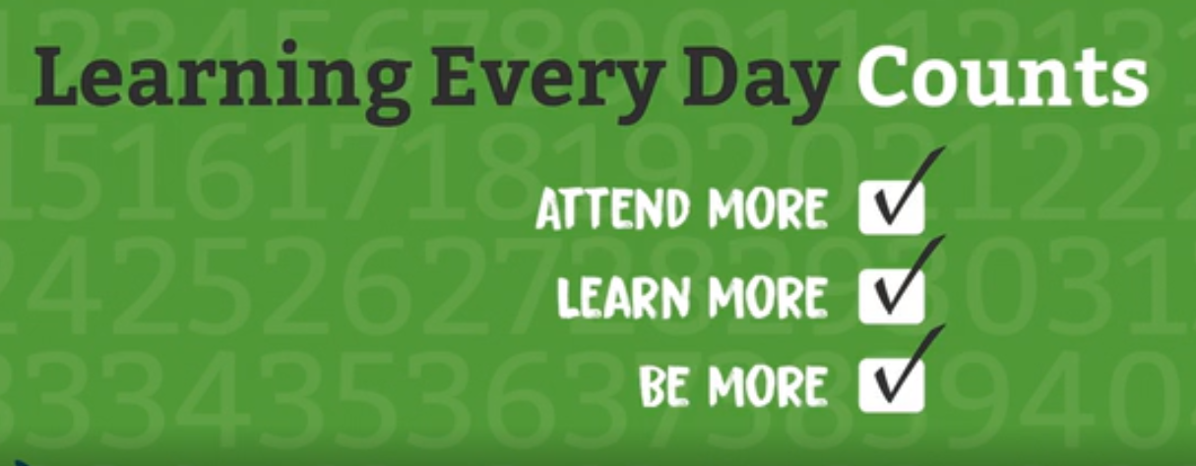
Attendance
Notes:
Click on pic for link to CSO Attendance video (50sec)
https://www.csodbb.catholic.edu.au/_uploads/ppage/files/Animation%20Only%20-%20Primary%20-%20Broken%20Bay%20Attendance.mp4
Using Compass to submit an absence. FULL DAYS ONLY - partial absences MUST be done via Kiosk in school offices. Do not drop your child off without coming in to sign them in using the Kiosk.
Supervision - Before school - begins at 8.15am. Children should not be onsite before this time (unless booked into OOSH). After school - children move to bus/ walk home/ Waratah Parade line up/ OOSH. There is no supervision after school. Legal requirement. Not a place for playdates.
Attendance - FAQs - https://stjohnsnarraweena.weebly.com/faqs.html. It is an expectation that students attend school every day unless they are sick. If a student is away from school there is a legal requirement for parents to notify the school (Compass). It is in a child’s best interest to not miss school but if your family do need to be away from school for a period of 10 days or more you need to get permission from principal prior to the absence (Application for Extended Leave)
If your child is not attending - why? If it is anxiety, etc - please let teacher know

Slide 6
What makes this year special?

Slide 7
Year 5 and Kindy buddies
Year 6 and Year 1 buddies
Leadership teams and responsibilities (Yr 5 and 6)
Sporting opportunities - Gala Days across the year
Opportunities to represent the school - in sport, academically, in extra-curricular activities
Canberra excursion - Term 2
Night of the Notables - Term 2
Debating - Year 6 - Term 4
Surf Awareness - Term 4
Expectations & development of independence, cooperative learning, research tasks, time management…
Year 5 parents - enrolment for High School (usually by May)

Slide 8
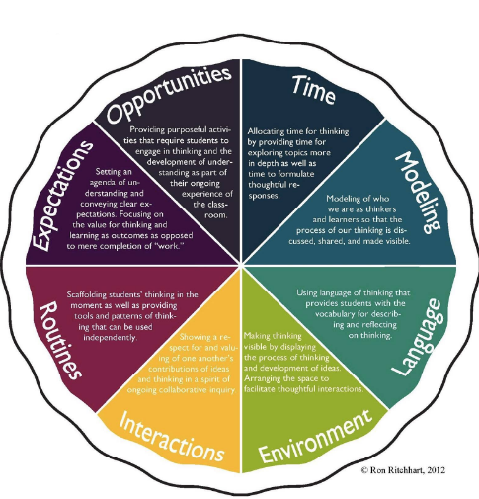
Culture of Thinking
We strive to create cultures of thinking in our classrooms by using a variety of methods, including making time for thinking, developing and using a language of thinking, making the classroom environment rich with scaffolds for thinking, and making our own thinking visible.
Notes:
Parents can support this at home - asking their children questions about what type of thinking they did at school today/ how they persisted with a challenge/ what new learning happened/ how it connected or challenged what they already knew...

Slide 9
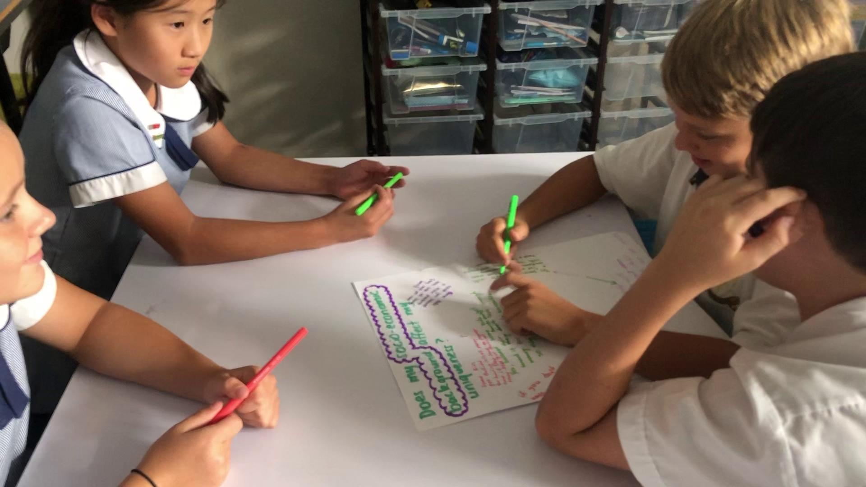
Example of
Thinking Routine:
CHALK TALK
PDHPE - Does my uniqueness change over time?
Notes:
An example of a thinking routine used in Year 6.

Slide 10
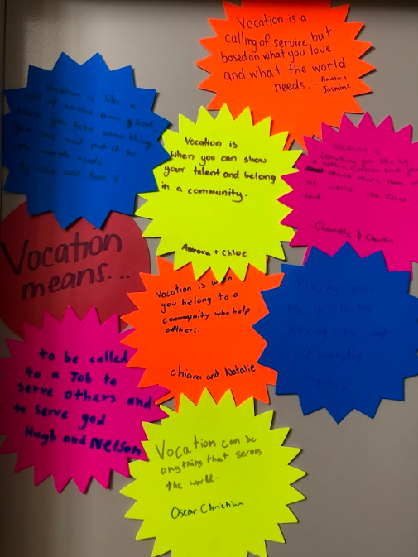
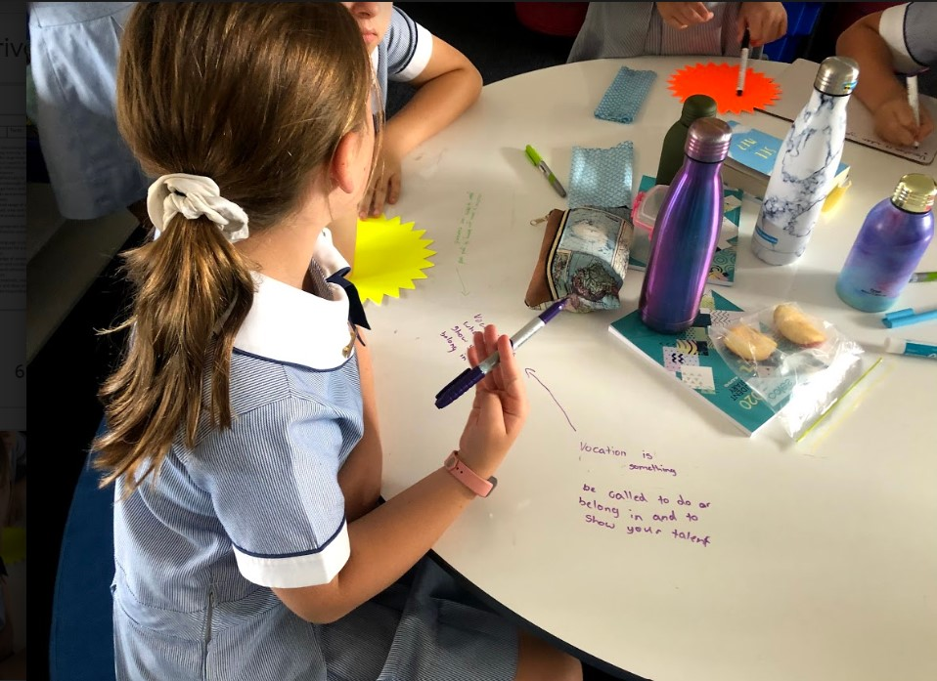
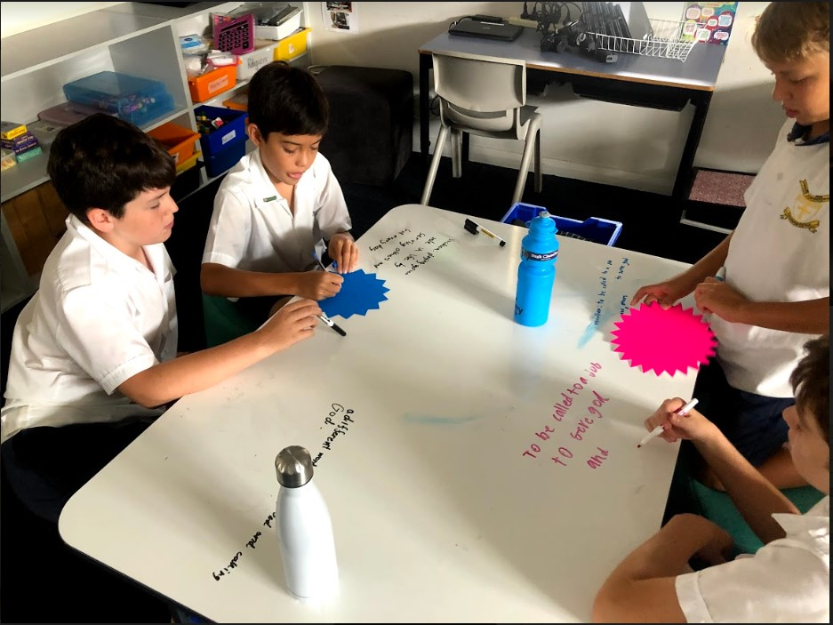
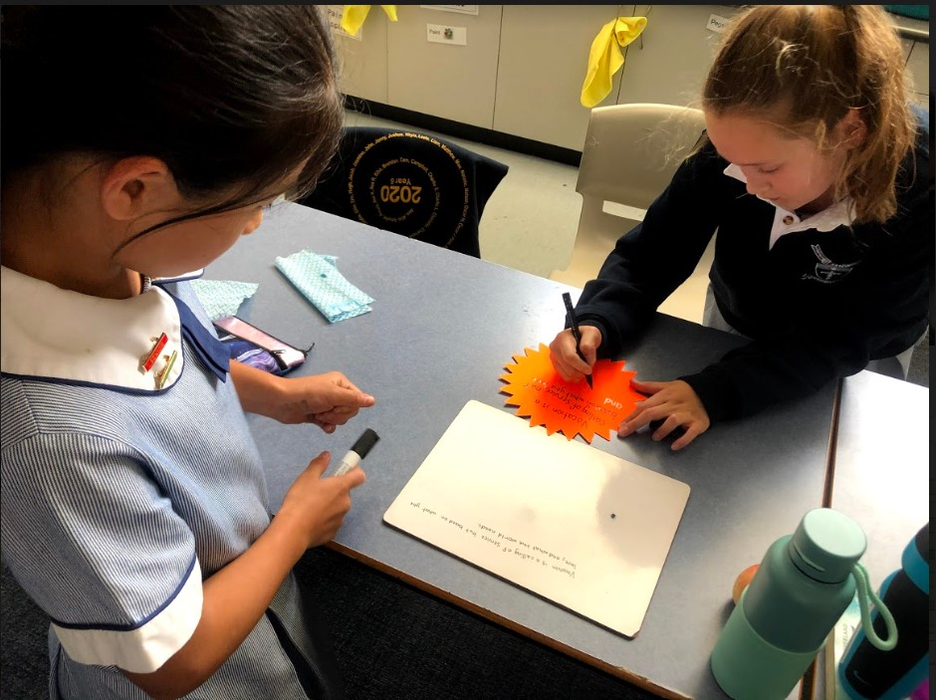
Example of
Thinking Routine:
HEADLINES
Religion - Vocation
Notes:
An example of a thinking routine used in Year 6.

Slide 11
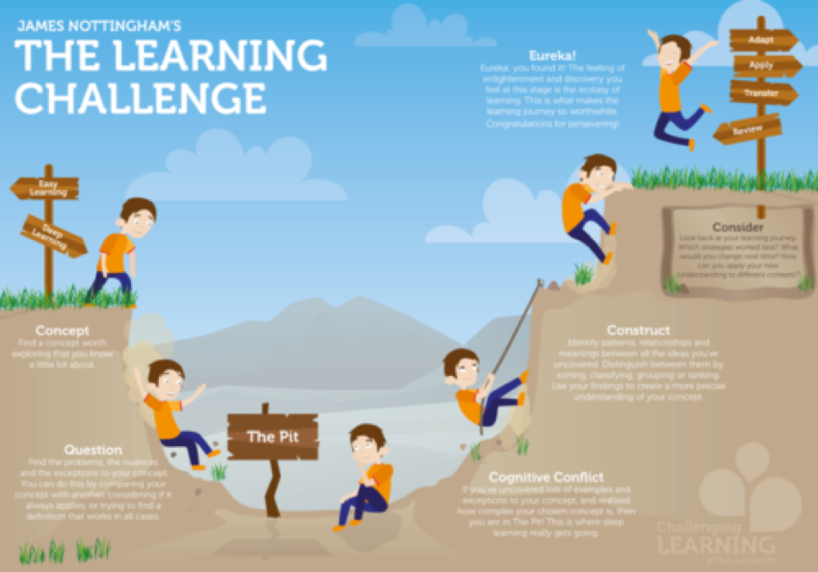
Growth Mindset
Notes:
Good intro to Growth Mindset for children - https://www.youtube.com/watch?v=BKisdb9tBYg (4min)
Discussion re The Learning Pit and how we use this language in our classroom.
The power of the word ‘yet’
How all of this ties into developing a Culture of Thinking in our school

Slide 12
Resilience
Resilience is the ability to recover from, or adjust to, misfortune or change.
It is a part of life.
It helps to prepare us for life.
“I am not my mistakes. I can try again. Things will get better. I am not alone.”
Notes:
Focus on resilience at St John’s this year.
Link to CoT and Growth Mindset and the power of ‘yet’.
Children need time to struggle - what this looks like in classroom and on playground.
How parents can help with this at home.

Slide 13
These are the types of learning this year
More opportunity for project-based/ investigative learning in all subjects
Technology used consistently across all areas of learning (eg Google Classroom, SeeSaw, iMovie)
Focus on development of independence, problem-solving, critical thinking and cooperative skills

Slide 14
Personal Development/ Health/ Pastoral Care
Deodorant! Yes, it’s time ;)
Information on sensitive issues units will be sent home later in the year
If there are things you think we need to know about your child, please touch base with us
Notes:
Camp, anxiety, puberty, etc

Slide 15
Home Learning Expectations
Reading
Reading to & reading with (children and adults)
Discussion about the text (build comprehension and inference)
https://education.nsw.gov.au/public-schools/practical-help-for-parents-and-carers/learning-resources/english/english-a-to-z/english-help-pages/comprehension-strategies-to-use-at-home
Maths
‘Discuss with parent’ home tasks - to build connection
Use of technology/ challenge of sharing tech in families
Home Learning - how it works in your family dynamic
Building up responsibility and time management skills
Notes:
Idea is to reinforce what is happening in the classroom, reading being most important, homework being practical and useful, assumption that parents are supporting the teachers in this,
Challenge of sharing technology in families - optional before school library time for using tech for homework, optional printing out tasks for children to take home
Discussion w parents tasks are about building connection, not that chn need to record
Home learning saved on Weebly - https://stjohnsnarraweena.weebly.com/home-learning1.html
Specifics about home learning in your grade/stage
https://education.nsw.gov.au/public-schools/practical-help-for-parents-and-carers/learning-resources/english/english-a-to-z/english-help-pages/comprehension-strategies-to-use-at-home

Slide 16
Communication and connection
“Parents play an important role in children’s learning, faith- development and well-being – and children generally do better when there are connections between the different spaces they learn in.”
Council of Catholic School Parents NSW/ACT
Notes:
http://www.ccsp.catholic.edu.au/parent-resources
Enlisting parent cooperation around achieving your goals.
How parents can get involved (Canteen, volunteer at excursions, carnivals, gala day, in the classroom, working bees) AND by coming along to school and community events (School Parish Masses, Movie night, Bush Dance) AND by reading the newsletter, following our Facebook page, looking at Weebly
Getting to know my child - sent home in Week 1 - helps teachers to get a better understanding of home life for your child

Slide 17
Communication and connection
St John’s Weebly - updated regularly to share your child’s learning
Compass - news feed for reminders/ last minute changes
Goal setting meetings - All families to book in for a meeting - will happen in the first few weeks of Term 2 (information re booking will be sent home at end of Term 1)
Semester reports - Parents can book an optional meeting after reports come home - talk to your teacher
Additional check-in meetings as needed - email us or call the office (or drop by and see us!)
Notes:
Communication expectations - for teachers
Goal setting meetings, reporting with optional meetings
Communication of learning (won’t have a Curriculum letter this year - teachers use Weeblies to share information on KLAs), COMPASS!!!!!
Newsletter - this is the main port of call for information - published Thursday afternoons
Email - we will endeavour to get back to you within 48 hours.
Weebly - we will update regularly - note pages for parents, homework and 5/6 home page - may also create a specific Year 6 page

Slide 18
Technology & your child
Social network | AU Minimum Age | EU Minimum Age
Facebook | 13 | 16
YouTube | 13 | 16
Snapchat | 13 | 16
TikTok | 13 | 16
Instagram | 13 | 16
WhatsApp | 13 | 16
Twitter | 13 | 16
Notes:
SO IMPORTANT - for parents to be VERY aware of how their children are using technology, what apps they are using (AND the age limits for those limits), and for parents to stay up to date with their own learning and expertise (unfortunately, just because you have an iPhone and a Facebook account doesn’t make you an expert…)
https://www.esafety.gov.au/parents - all parents should have this bookmarked!!
https://www.newidea.com.au/social-media-age-restrictions-what-are-the-age-limits
https://stjohnsnarraweena.weebly.com/keeping-safe.html – Carly Ryan Fact sheets are really useful information for many social network apps

Slide 19
Expectations - for a Year 5 & 6 child
Be responsible for own home learning, notes, belongings etc
To work independently to the best of their ability
Develop resilience and self regulation
To be a kind friend to others
To ask for help when needed
Being a leader and role model to their peers

Slide 20
Expectations - for parents
Check newsletters, Weebly and Compass regularly
Use Compass promptly to inform school of absences – (and use kiosk for lateness, appointments etc)
Communicate any concerns or other outside school support your child is receiving to the teachers - and communicate first with your class teacher!
Ensure all belongings are labelled and student supplies are maintained
Get involved in school life - in whatever ways you can.
Notes:
Communication expectation (email, weebly, etc) - FOR PARENTS
Compass- please ensure you have downloaded it and stay up to date with the ‘news’. Can also use to submit absences (FULL DAYS ONLY - partial absences MUST be done via Kiosk in school offices)
Newsletter - this is the main port of call for information - published Thursday afternoons
Importance of responding to information.

Slide 21
Expectations - for teachers
To support your child in developing as a thinker
To support your child in developing as a resilient person with a growth mindset
Keep Weebly and messages updated.
Notify and meet with parents promptly regarding any concerns or issues – behaviour, social, emotional, physical, academic, language
To provide a safe, stimulating and challenging working environment – follow PBL framework

Slide 22
Thanks!
Any questions?

